Slide 1
The integrated dial-a-ride problem with timetabled fixed route service
Marcus Posada, Henrik Andersson and Carl Henrik Häll

Slide 2
Introduction

Slide 3
The Integrated Dial-a-Ride Problem
Demand responsive door-to-door transportation for the elderly and/or disabled
The IDARP is an extension of the DARP

Slide 4
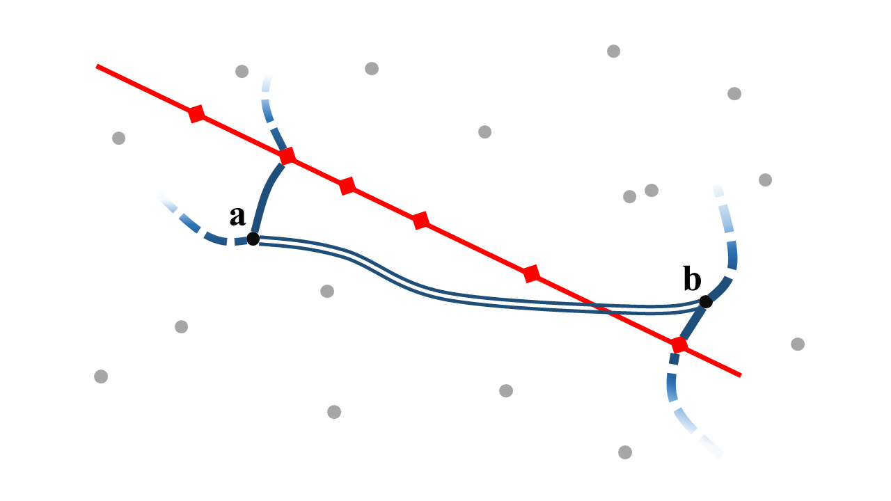
The Integrated Dial-a-Ride Problem

Slide 5
Contributions
Two main parts:
1) extensions and generalization of the model in Häll et al 2009.
2) changes to the model structure in order to reduce network size and solving time.

Slide 6
Generalizations and extensions
Timetables – impacts travel times and triangle inequalities
Inhomogeneous vehicle fleet – costs, (travel times) and capacities
Relaxation of pick-up/drop-off constraints for special cases

Slide 9
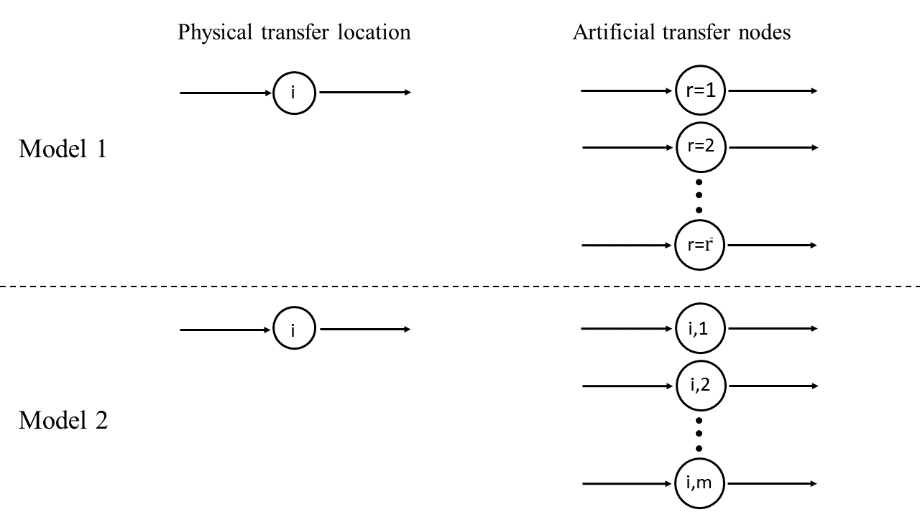
An alternative nodal structure

Slide 10
Evaluation

Slide 11
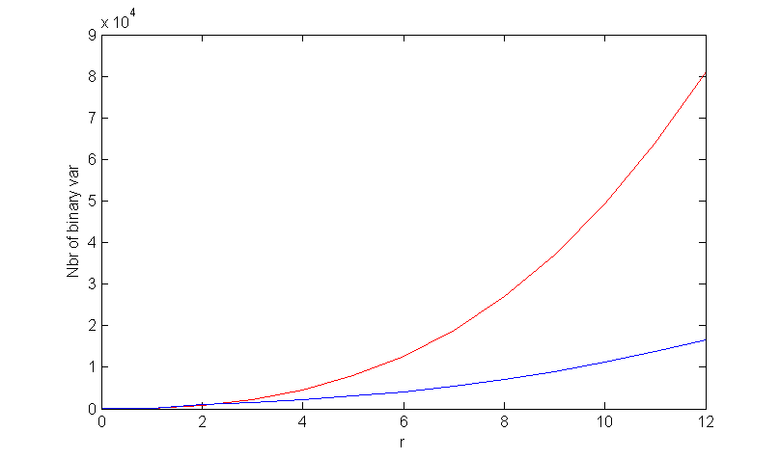
Binary variables

Slide 12
Evaluation scenario

Slide 13
Computational times

Slide 14
Memory usage

Slide 15
Summary and Conclusions
The IDARP is extended to describe real world scenarios better
Two different nodal structures for the transfer points are presented
Modeling choices greatly influence the solvability of the problem
It is still not reasonable to solve the IDARP to optimality

Slide 16
Possible future research
Exact solutions: stronger valid inequalities, branching techniques, column generation.
Inexact solution methods: develop a heuristic solver. Handle dynamic problem instances.
Evaluate the effects of introducing an integrated demand responsive system.

Slide 17




Collaboration

Slide 18
Marcus Posada, Henrik Andersson and Carl Henrik Häll

