Slide 1




INOC 2013
May 2013, Tenerife, Spain
Train unit scheduling with
bi-level capacity requirements
Zhiyuan Lin, Eva Barrena, Raymond Kwan
School of Computing, University of Leeds, UK
CASPT
23 July 2015, Rotterdam
Notes:
cover

Slide 2
Outline
Motivation
Problem description
  - Capacity levels
Model
Computational experiments
Conclusions and further work
Notes:
Introduction: problem description

Slide 3
Motivation
Train unit scheduling problem
Minimize operating costs
Satisfy capacity requirements
Best representation
Various
sources
Imprecise definition
How?
Re-balance
Imbalanced demands
Under-utilized train units
Notes:
Given a fixed timetable with train services and a fleet of different types of train unit, the TUSP aims to
Two problems are identified regarding capacity requirements: (1) unknown/unclear even for the train operators;(2) not manually produced; due to the nature of optimization models.

Slide 4
Outline
Motivation
Problem description
  Capacity levels
Model
Computational experiments
Conclusions and further work

Slide 5

Train units
Class 171/7 (2-car), diesel
Class 375 (4-car), electric

Slide 6
Train unit scheduling
Train unit scheduling problem
Train ID | Origin | Destination | Dep time | Arr time | demands
2E59 | A | B | 09:05 | 10:15 | 125
2G15 | B | C | 10:30 | 12:25 | 206
2G71 | C | D | 15:00 | 17:35 | 196
Path (source to sink)
Scheduled work for a train unit
Train node
2G71
C→D
Sign-off arc
Empty-running
connection arc
source s
Sign-on arc
sink t
2E59
A→B
Station connection arc
2G15
B→C

Slide 7

Train unit scheduling
Integer multicommodity flow representation
1E06
1E06
1E09
1E09
x1
sink
source
2E11
2E11
2E11
2E32
x1
2E32
2E03
2E03
Paths may overlap for coupling
Coupled units may be of different but compatible types
Notes:
Other issues: locations banned for cpl/decpl; additional time consumed by cpl/decpl; unit type compatibility; unit blockage at stations

Slide 8
Outline
Train capacity requirements
Capacity requirement can be inferred from:
  Mandatory minimum provision
  Historic provision
  Passenger count surveys (PAX)
  Future growth expectation
Problems of a single level:
  Requirements not precisely defined / unknown
  Under-utilized train units as a result of optimization techniques
Notes:
Bare minimum required by transport authorities; operated train unit schedules from previous years; actual passenger number manually counted on a subset of trains;
none of them can represent the realistic requirement level

Slide 9
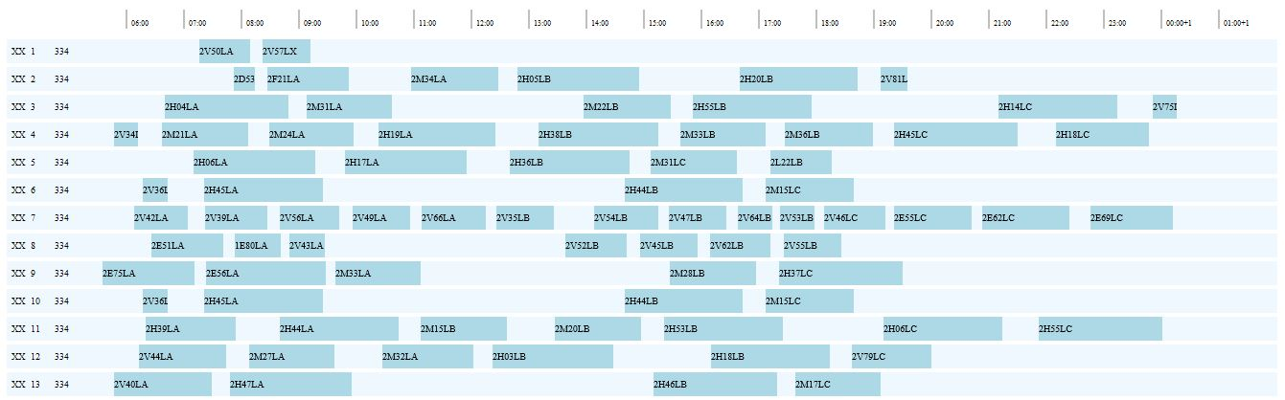
Under-utilized train units

Slide 10
Outline
Historic capacity provision
Implicit information
  Pattern of unit resource distribution
  Agreements/expectations with transport authorities
Potential problems
  Capacity strengthening could be used for unit resource redistribution: didn’t reflecting the real level
  Unreasonable pattern may stay in past schedules for years
Notes:
Introduction—train units

Slide 11

Outline
Historic capacity provision
Capacity strengthening for unit resource redistribution in historic provision: an example
i
A
B
Requires 1 unit
m
n
B
D
D
E
Requires 1 unit
Requires 2 units
j
C
B
Requires 1 unit
Notes:
(1) D is banned for cpl/decpl, but B can; (2) The red unit has to do an empty-running from B to D o/w

Slide 12
Outline
PAX surveys
Actual passenger counts
Only a subset of trains surveyed
Might contradict with historic provisions
Frequency and scale of surveys vary among operators
Notes:
Introduction—train units

Slide 13
Outline
OP and UP trains
Over-provided (OP): if historic capacity > PAX in terms of number of train units
Under-provided (UP): if historic capacity < PAX
  No place available for coupling/decoupling
  Result of under-optimized schedules
  OP: Used for redistributing train unit resources
  UP: May be inevitable due to limited fleet size and/or coupling upper bound
Notes:
Introduction: problem description

Slide 14
Outline
Bi-level capacity requirement
(per train j)
A desirable level r’_{j}
  Will be satisfied as much as possible
  max {historic, PAX, …}
A target level r_{j}
  Must be strictly satisfied
  min {historic, PAX, …}
Notes:
Introduction—train units

Slide 15
Outline
Bi-level capacity requirement
Historic capacity
PAX
Desirable capacity
Model
Future growth
Scheduled capacity
Target capacity
Mandatory minimum
…
information
Input data
Output data
Notes:
Introduction—train units

Slide 16
Outline
Motivation
Problem description
  Capacity levels
Model
Computational experiments
Conclusions and further work

Slide 17
Outline
The integer multicommodity
flow formulation
Objective function
  Minimize operating costs, including
    Fleet size, mileage, empty-running
  Reflect preferences on, e.g., long idle gaps for maintenance
  Achieve the desirable capacity requirements level as much as possible

Slide 18
Outline
The integer multicommodity
flow formulation
Constraints
  Fleet size bounds
  Target capacity requirement
  Coupling of compatible types
  Complex coupling upper bounds
combined into “train convex hulls”

Slide 19
Outline
The formulation
Variables
Path variable
number of units used for path p of type k
Capacity provision variable
The capacity provided by the solver at train j

Slide 20
Outline
Desirable level r′
Realized in the objective
Minimize the deviation between y and r′
Operating cost
Desirable capacity
level
Get the capacity provision in constraints
Deal with the absolute values
Notes:
Of will measure how well the model satisfies the desirable level capacity requirements

Slide 21
Outline
The ILP formulation
(1) Objective
(2) Fleet size upper bound
(3) Convex hulls for all trains
(4) Calculate capacity provision variables
(5)(6) Variable domain
Notes:
I’ll skip the solution approach on the model. It is solved by branch-and-price with ad-hoc branching strategies.

Slide 22
Outline
Motivation
Problem description
  Capacity levels
Model
Computational experiments
Conclusions and further work

Slide 23


Computational experiments:
Objective function terms
Objective function - Competing terms
  Deviation from
  desirable level
  Operating costs:
  Fleet size,
  mileage,
  ...
Weights
$$C_{1}$$
$$C_{2}$$

Slide 24
Computational experiments
Purposes
Calibrate the objective function weights
Satisfy as much as possible the desirable capacity level for a given fleet size
Compare with manual schedules
Experiments
E1: Varying weights in the objective function
E2: Fix fleet size & solely minimize r’ deviation

Slide 25
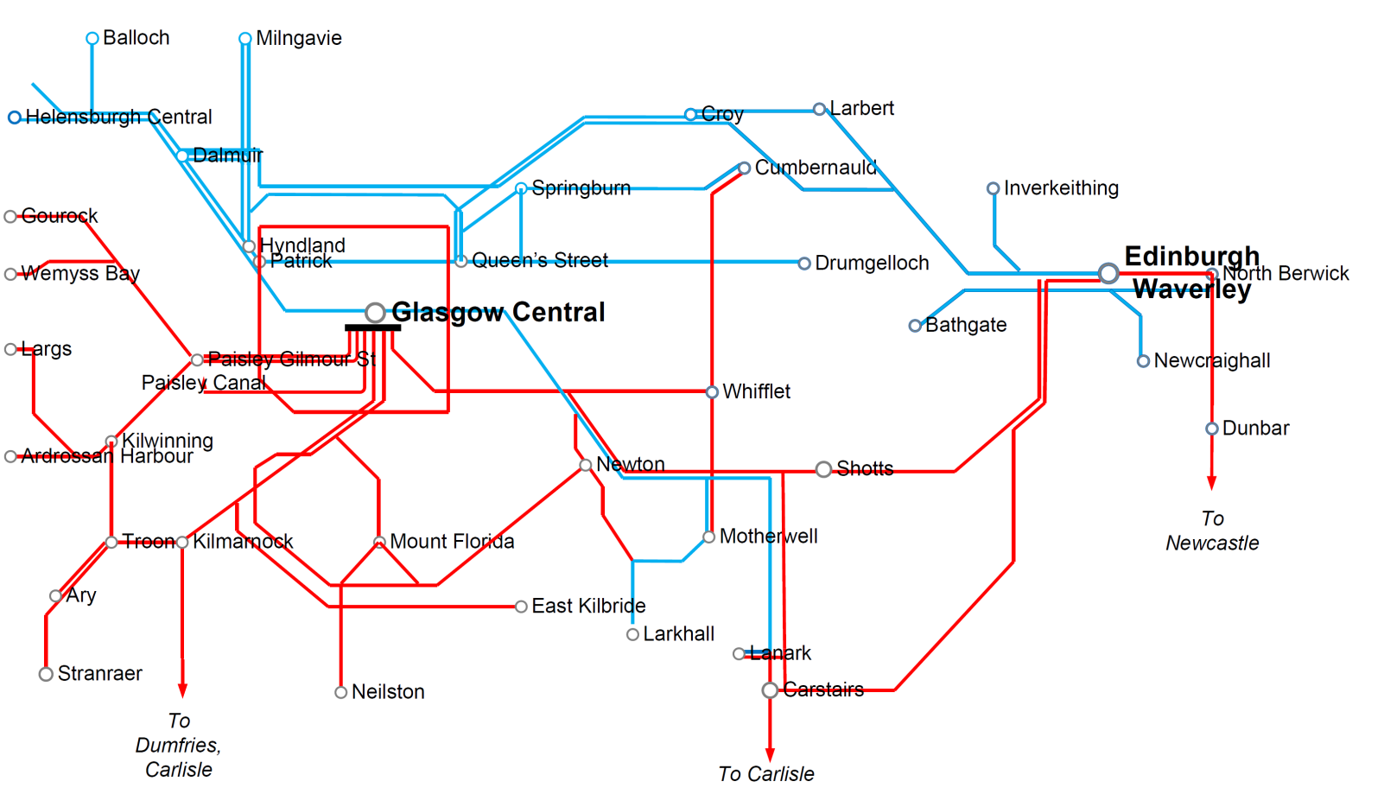
Computational experiments
Central Scotland railway network; December 2011 timetable

Slide 26
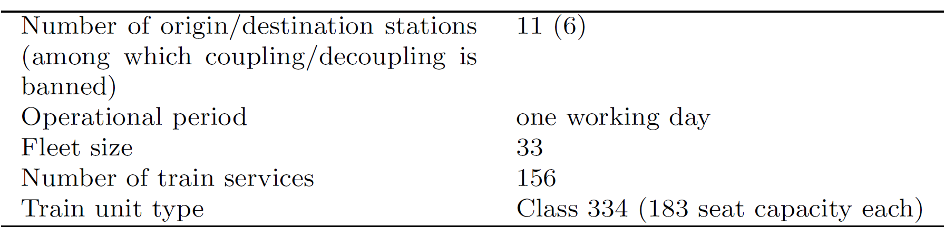
Computational experiments:
Input data
Actually operated schedule: 64 OP trains out of 156
If use PAX, solver = 29 units
If use historic capacity, solver = 33 units

Slide 27
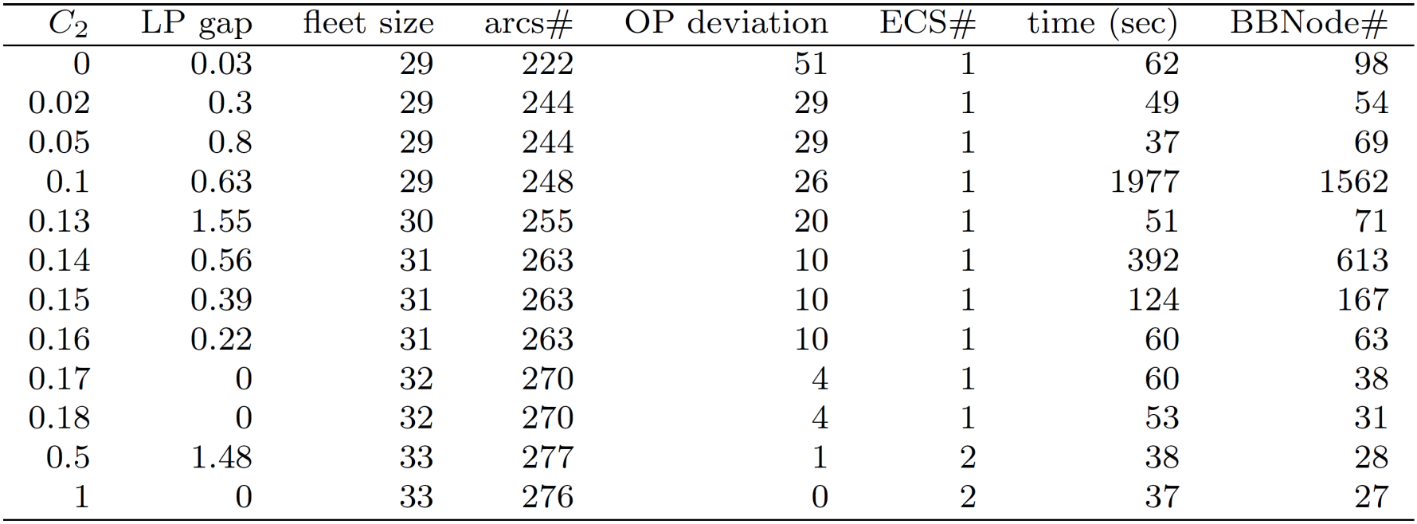

Computational experiments:
Results on E1
E1: Varying weights in the objective function. $C_{1}+C_{2}=1$

Slide 28
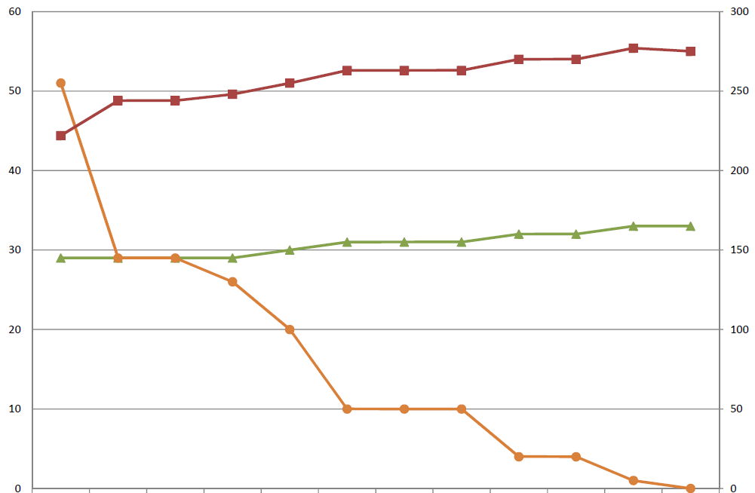


Computational experiments:
Results on E1
Varying weights in the objective function$C_{1}+C_{2}=1$
Experiments (increasing $C_{2})$

Slide 29
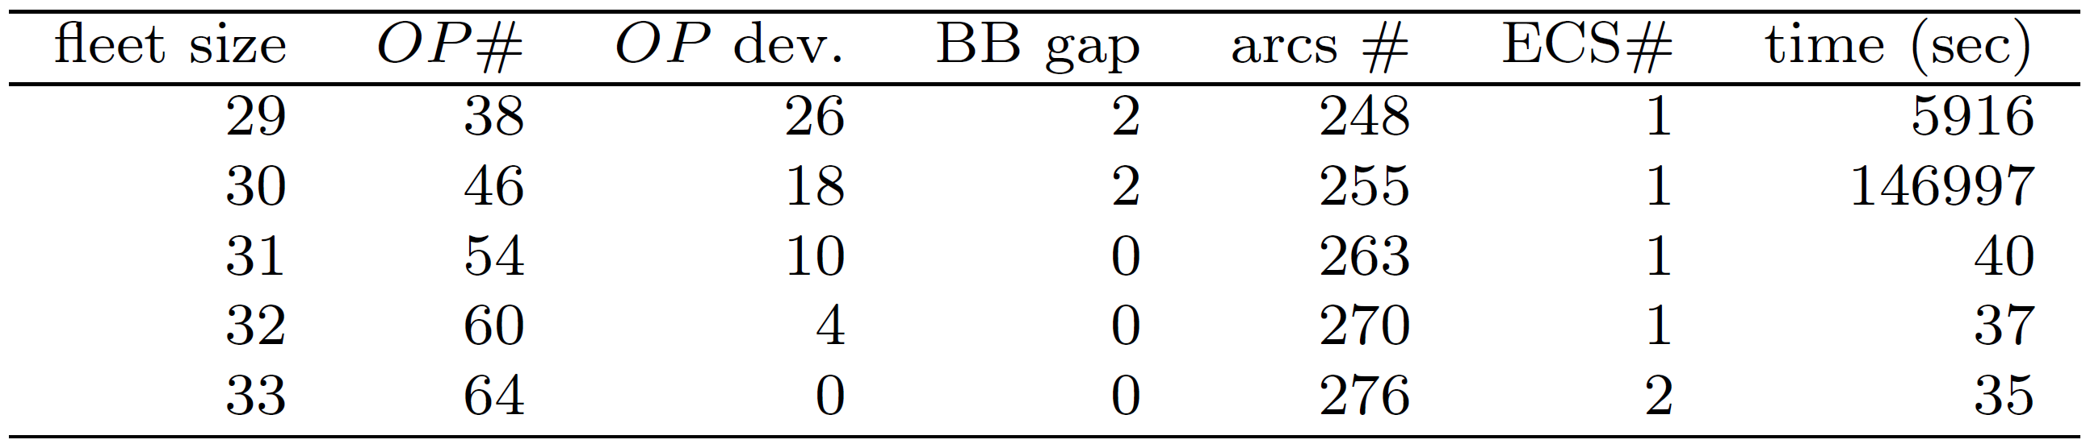
Computational experiments:
Results on E2
E2: Fix fleet size & solely minimize OP deviation

Slide 30


Computational experiments:
Comparison between E1 & E2
E2
E1
Actually operating schedule: Fleet size= 33, OP=64
Notes:
Arcs # in manual schedule? Approximated time?

Slide 31
Conclusions
Train unit scheduling with bi-level capacity requirements:
  Target: PAX; Desirable: historic provisions
  Schedules with more reasonable/controlled capacities
Improvements w.r.t. manual schedules:
  12% reduction of fleet size
  Maintaining nearly 60% OP trains

Slide 32
Further work
UP trains & limited fleet size
Multicriteria optimization
Trade-offs between depot returns and maximizing capacity provision
More problem contexts in train unit resource planning, e.g.
  franchise bidding
  maintenance scheduling

Slide 33
Thank you!

