Slide 1
Super express services operated on urban highways: The opportunity of a new metropolitan transport mode
M. Navarro, J. Muñoz, C. Bucknell & A. Schmidt
CASPT2015

Slide 2
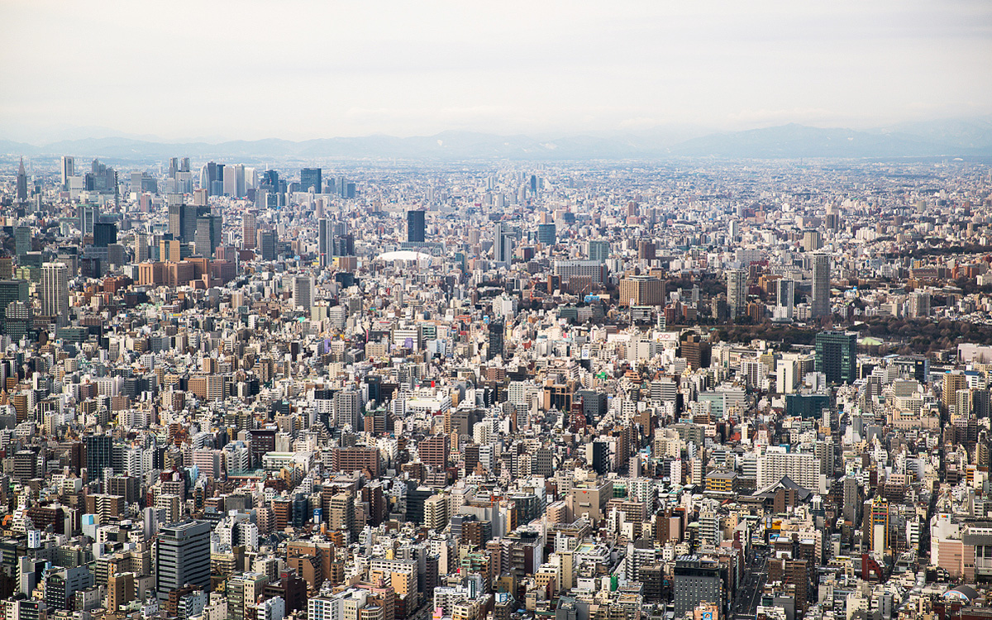
Cities with large metropolitan areas are present everywhere in the world…

Slide 3
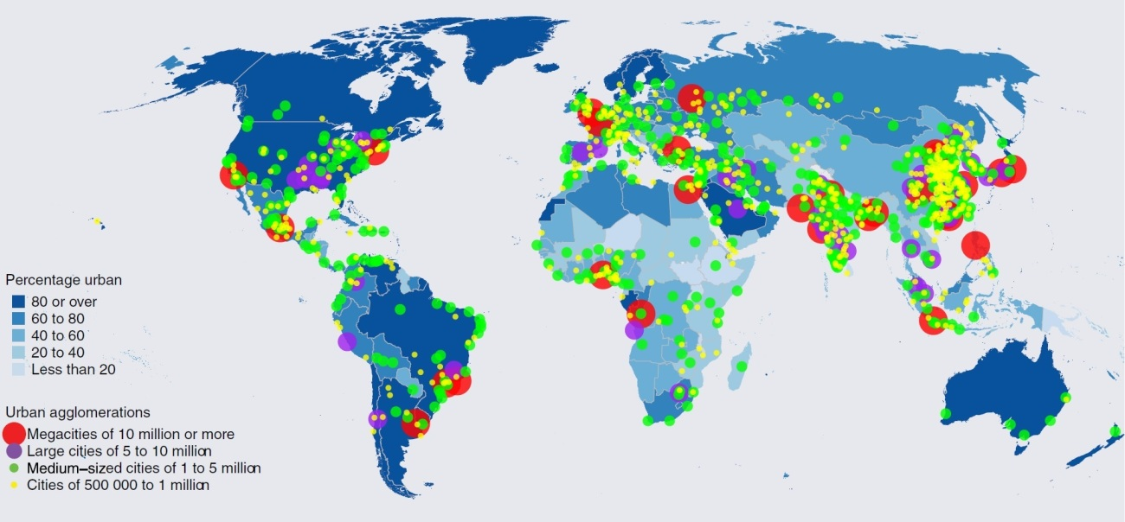
In fact, today more than 60 cities in the world exceed 5 million inhabitants

Slide 4
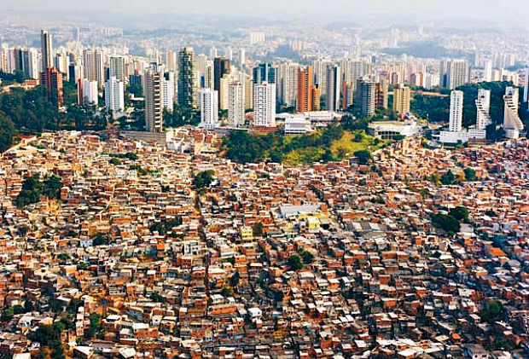
And, in the case of Latin America, there is a lot of social segregation (Sabatini et al.,2001).

Slide 5



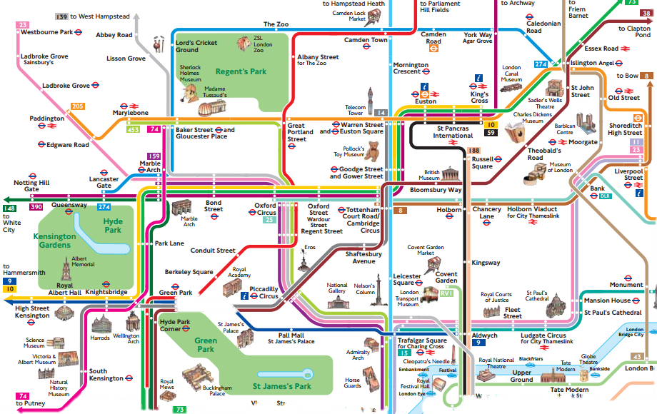


That is…
¿ ?
Bigger cities
(Duranton & Puga, 2013)
Longer trips
Stressed public transport
Notes:
For example, more than 20% of the trips on public transport in cities extend for over 15km (Bus Rapid Transit Centre of Excellence, 2012)
Porto Alegre (22%)
Guadalajara (24%)
Mexico City (61%)
Bogotá (40%)
Lima (23%)

Slide 6



What current alternative transport modes do we have to face this situation?
Metro
  60.000 pax/h and 30 km/h.
  Passengers who make long trips usually must make transfers.
  At peak hours presents significant overcrowding on carriages and stations.
Buses in segregated lanes (BRT)
  45.000 pax/h and 25 km/h.
  When it is an open corridor, this reduces the need for transfers.
  Outside the corridor, the bus must share the road with other vehicles.
Automobile on urban highways
  2 pax/vehicle (low productivity) and 80 km/h
  At peak hours, this is the main cause of traffic jams in the urban transport system.
  For people with less purchasing power, it is beyond their financial capabilities.

Slide 7
So, …

Slide 8
Hypothesis and Objective
Hypothesis
A bus service with a reduced amount of stops and operated on urban highways can carry out these trips in a more efficient manner.
Objective
In order to corroborate our hypothesis, we will review the experience of the super express services which utilize urban highways in Santiago, Chile and analyze the advantages and disadvantages of these type of services.

Slide 9
The experience of Santiago, Chile
Travel patterns
Network of urban highways and the public transport system
Bus services on the highway

Slide 10
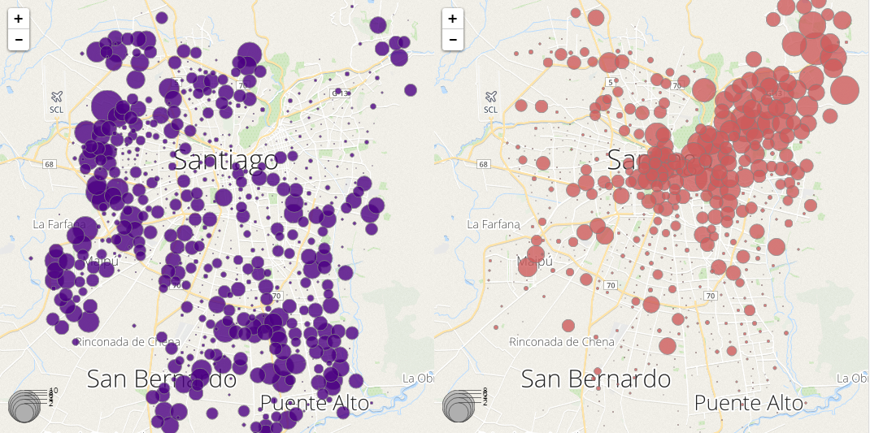
Travel patterns
Origins
Destinations
We estimated that 26% of the total amount of trips made on the public transport system at peak hours travel more than 20 km in order to reach a destination.

Slide 11
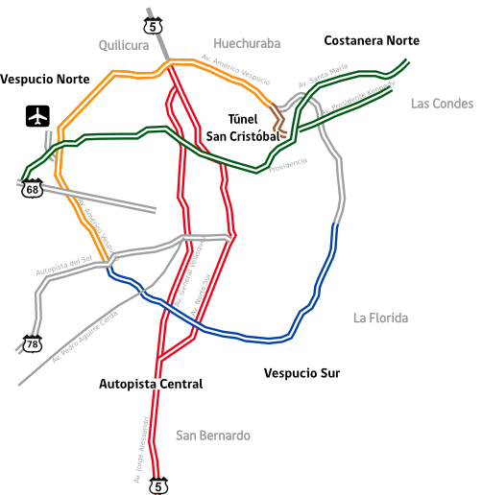
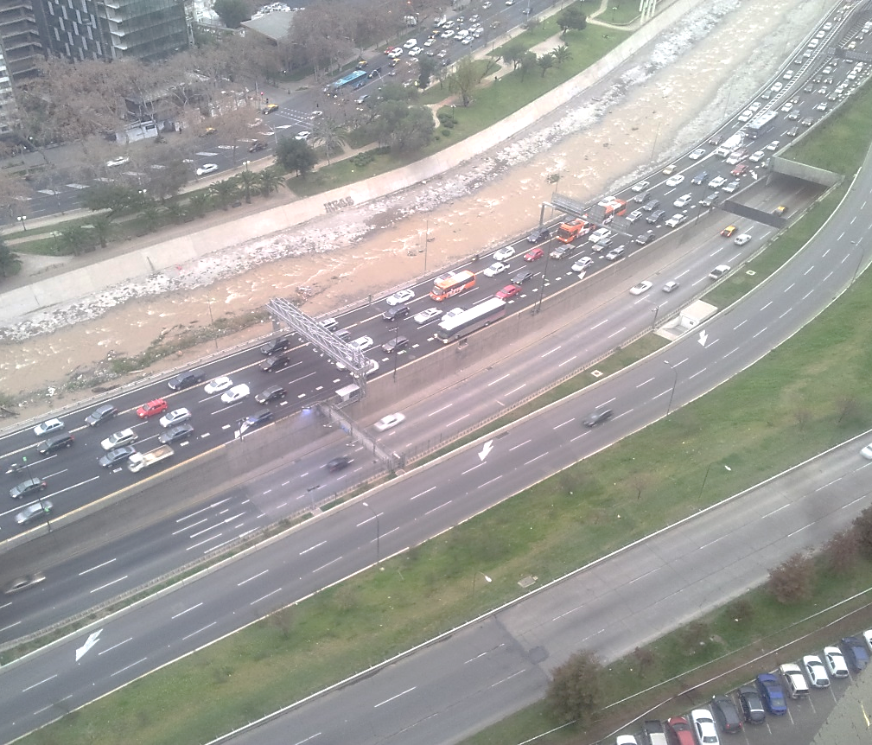
Urban highways
Santiago has a network of urban highways extending over 207 km and commercial speeds are close to 60 km/h for buses.
At peak hours there is a high level of congestion in one direction, while in the opposite direction there is a considerable sub utilization of these same roadways.
Costanera Norte
Notes:
Tener respuesta a que la congestión afecta a la dirección de regreso de los buses.

Slide 12

The public transport system
The system has an integrated fare which includes Metro and Buses. This permits the users making two transfers between modes within a period of two hours.
+
+
+
+
+
+
Fares are collected by the transport authority, who makes a payment to each operator. It represents the financial cost of each trip for the system.

Slide 13
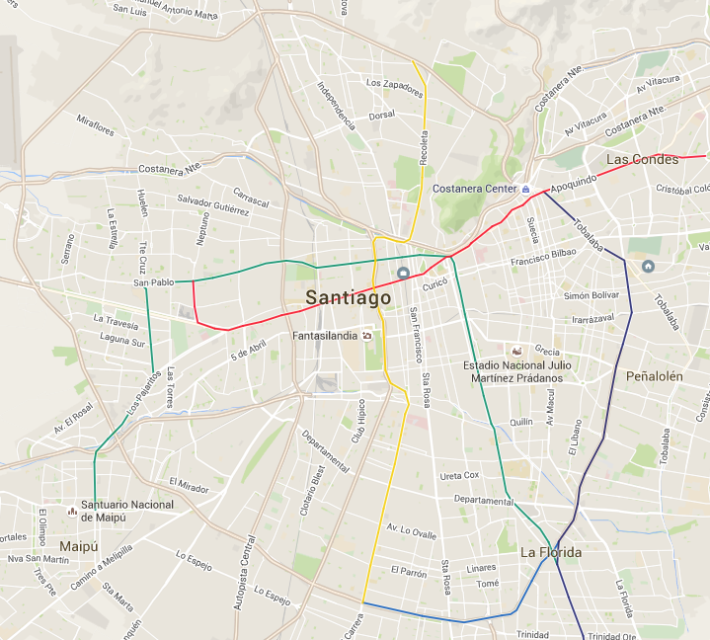



Bus services on the highway
Advantages: Travel time and financial cost
Trip at 7:30 am | 1 | 2 | 3
Travel time [min] | 58 | 68 | 45
N° of operators | 2 | 2 | 1
Financial cost [USD/pax] | 1.29 | 1.29 | 0.96
Fare [USD/pax] | 1.11 | 1.11 | 0.98

Slide 14
But, also there are some concerns…

Slide 15
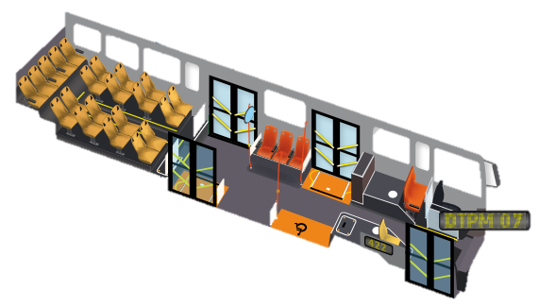
Bus services on the highway
Disadvantages: Types of buses
When the commercial speed is close to 60 km/h, any collision has a high probability of resulting in death for those involved (Nilsson, 2004).
This type of bus becomes inconvenient as it does not comply with the minimum safety standards.
For example, one of the current type of bus offers seats for only 26% of its total capacity.
Notes:
Revisar lo de los cinturones de seguridad

Slide 16
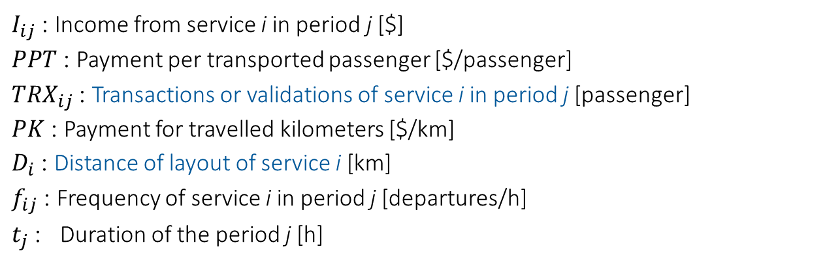

Bus services on the highway
Disadvantages: Payment method to bus operators
Income
Income per km
$$I_{ij}=PPT∗{TRX}_{ij}+PK∗D_{i}∗f_{ij}∗t_{j}$$
Income per pax
$I_{ij}$ : Income from service i in period j [$]
$PPT$ : Payment per transported passenger [$/passenger]
${TRX}_{ij}$ : Transactions or validations of service i in period j [passenger]
$PK$ : Payment for travelled kilometers [$/km]
$D_{i}$ : Distance of layout of service i [km]
$f_{ij}$ : Frequency of service i in period j [departures/h]
$t_{j}$ : Duration of the period j [h]

Slide 17
Analysis of the payment scheme
Definitions
Economic evaluation of current payment scheme
Economic evaluation of the new payment scheme

Slide 18
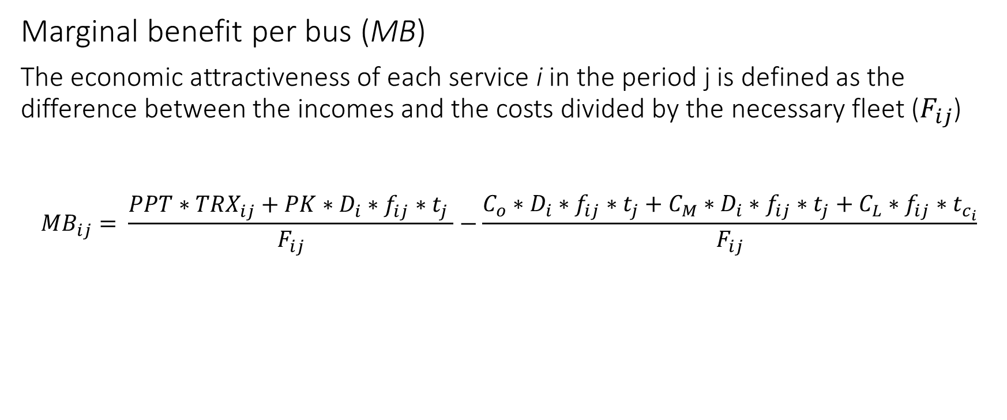
Definitions
Measure of economic attractiveness
Marginal benefit per bus (MB)
The economic attractiveness of each service i in the period j is defined as the difference between the incomes and the costs divided by the necessary fleet ($F_{ij}$)
$${MB}_{ij}= \frac{PPT∗{TRX}_{ij}+PK∗D_{i}∗f_{ij}∗t_{j} }{F_{ij}}−\frac{C_{o}∗D_{i}∗f_{ij}∗t_{j}+C_{M}∗D_{i}∗f_{ij}∗t_{j}+C_{L}∗f_{ij}∗t_{c_{i}}}{F_{ij}}$$
Income
Operational cost
Fleet
Fleet

Slide 19
Definitions
Types of services
Super Express Services (SE): Services which connect remote urban origins and destinations in a fast way.
Business Hub Services (BH): Services which cover the business hub of the city.
Metro Station Services (2M): Services which cross 2 or more Metro stations.

Slide 20
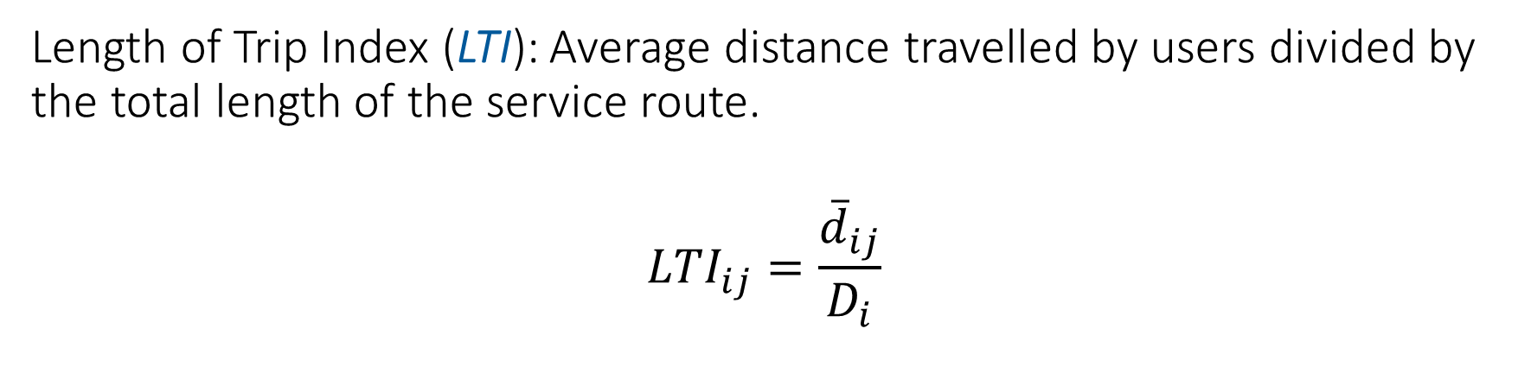
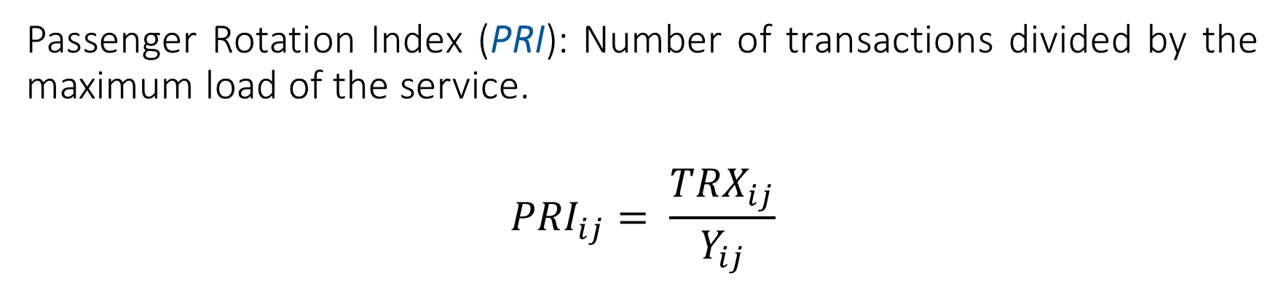
Definitions
Characteristics of the different types of services
Passenger Rotation Index (PRI): Number of transactions divided by the maximum load of the service.
$${PRI}_{ij}= \frac{{TRX}_{ij}}{Y_{ij}}$$
Length of Trip Index (LTI): Average distance travelled by users divided by the total length of the service route.
$${LTI}_{ij}=\frac{{\overline{d}}_{ij}}{D_{i}}$$

Slide 21
LTI vs PRI
Scatter plot for all the services of the public transport system
Super express service
Business hub service
Metro stations service

Slide 22
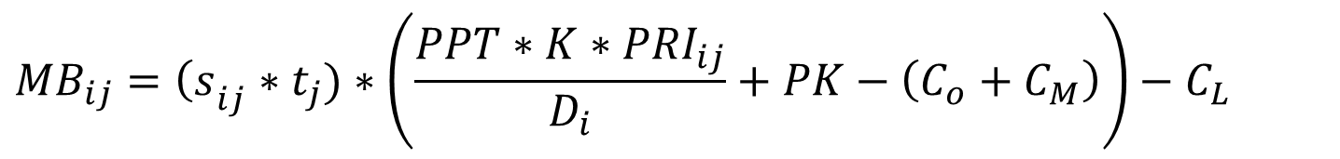
Economic evaluation of current payment scheme
Using the passenger rotation index (PRI), we can rewrite the income formula of a given service i in a same period j
$$I_{ij}=PPT∗Y_{ij}∗{PRI}_{ij}∗t_{j}+PK∗D_{i}∗f_{ij}∗t_{j}$$
Therefore, the marginal benefit per bus is:
$${MB}_{ij}={\left(s\right.}_{ij}∗t_{j})∗\left(\frac{PPT∗K∗{PRI}_{ij}}{D_{i}}+PK−\left(C_{o}+C_{M}\right)\right)−C_{L}$$

Slide 23
Economic evaluation of current payment scheme
Comparison of marginal benefit per bus
Notes:
Poner ojo en esta explicación para que queda clara. El ale se perdió acá.

Slide 24
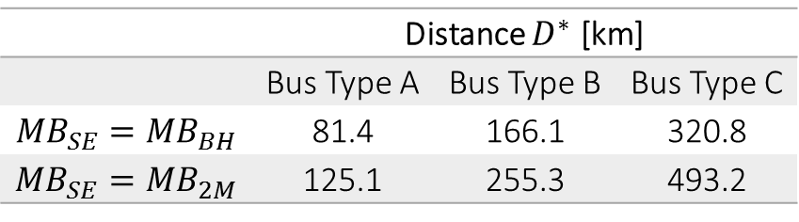
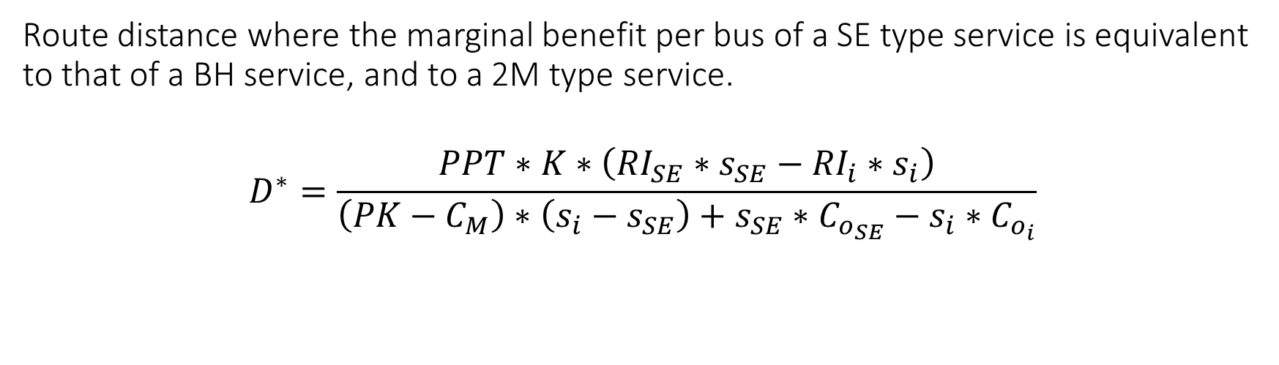
Economic evaluation of current payment scheme
Route distance where the marginal benefit per bus of a SE type service is equivalent to that of a BH service, and to a 2M type service.
$$D^{∗}=\frac{PPT∗K∗\left({RI}_{SE}∗s_{SE}−{RI}_{i}∗s_{i}\right)}{\left(PK−C_{M}\right)∗\left(s_{i}−s_{SE}\right)+s_{SE}∗C_{o_{SE}}−s_{i}∗C_{o_{i}}}$$
 | Distance $D^{∗}$ [km]
 | Bus Type A | Bus Type B | Bus Type C
$${MB}_{SE}={MB}_{BH}$$ | 81.4 | 166.1 | 320.8
$${MB}_{SE}={MB}_{2M}$$ | 125.1 | 255.3 | 493.2
Long route distances!

Slide 25
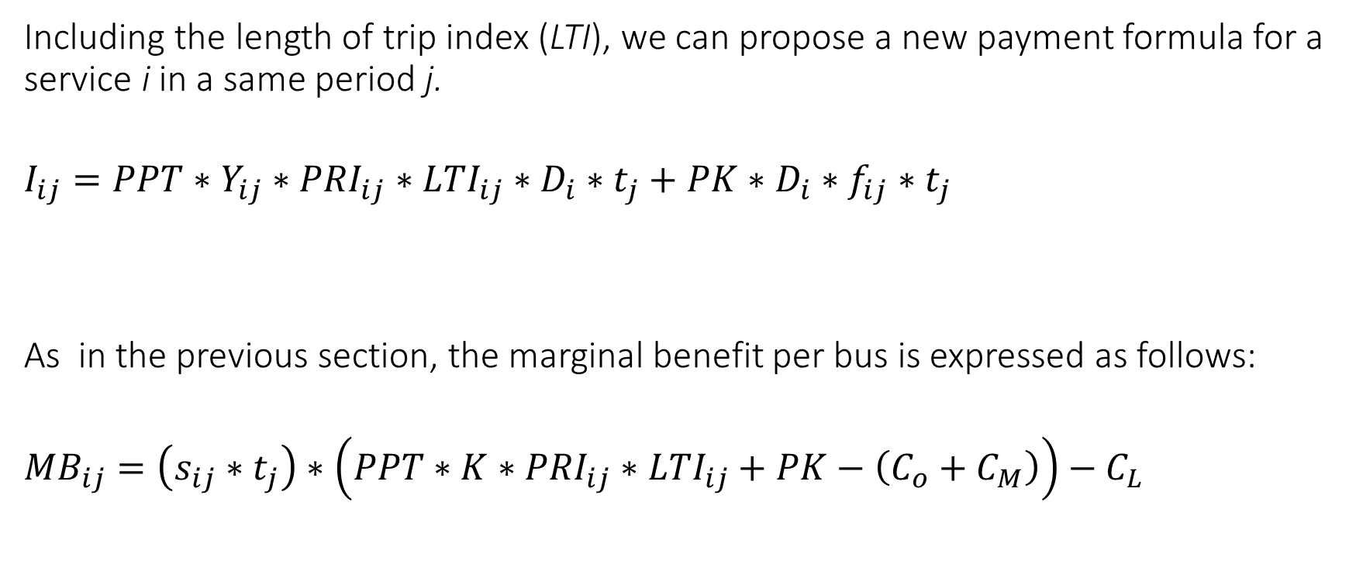
Economic evaluation of the new payment scheme
Including the length of trip index (LTI), we can propose a new payment formula for a service i in a same period j.
$$I_{ij}=PPT∗Y_{ij}∗{PRI}_{ij}∗{LTI}_{ij}∗D_{i}∗t_{j}+PK∗D_{i}∗f_{ij}∗t_{j}$$
As in the previous section, the marginal benefit per bus is expressed as follows:
$${MB}_{ij}=\left(s_{ij}∗t_{j}\right)∗\left(PPT∗K∗{PRI}_{ij}∗{LTI}_{ij}+PK−\left(C_{o}+C_{M}\right)\right)−C_{L}$$

Slide 26
Economic evaluation of the new payment scheme

Slide 27
Conclusions
Summary
Lessons
Perspectives

Slide 28
Summary
The growing expansion of cities has promoted an increase in the number of long trips.

Slide 29
Summary
Fare integration and urban highways allow approaching the different transport modes with network logic and combining them to deliver better alternatives for users.
+

Slide 30
Lessons
Santiago’s experience has shown us that super express services can be a great opportunity to solve long trips but also present important challenges:
  Transporting standing passengers at high speeds has a high risk in the event of accidents.
  Payment schemes where do not differentiate the length of the trip tend to de-incentivize services with few stops.
A new payment scheme based on passenger-kilometer could balance the attractiveness of different types of services from the bus operators point of view.
1
2
Notes:
Revisar el inglés

Slide 31
Perspectives
To study in detail the performance of the passenger rotation index (PRI) as the distance of the bus route is increased.
To calibrate or scale the operational speed together with PRI and LTI in order to set a balanced marginal benefit per bus.
To rethink the design of the buses used for super express services.

Slide 32
Super express services operated on urban highways: The opportunity of a new metropolitan transport mode
M. Navarro, J. Muñoz, C. Bucknell & A. Schmidt
CASPT2015

Slide 33
Appendix
We could fit a function in the relation between PRI and LTI in order to provide a better calibration of the new income formula.

