Slide 1
Robust train routing in station areas with reducing capacity utilization
The 13th Conference on Advanced Systems in Public Transport
CASPT 2015
Nikola Bešinović, Rob M.P. Goverde
Rotterdam, 20-07-2015

Slide 2
Outline
Introduction | Motivation | Methodology | Case study | Discussion
Introduction
Motivation
Solution approach
  Preprocessing
  Original Train Routing Problem (TRP)
  Extension to Robust Train Routing Problem (RTRP)
  RTRP heuristics
Case study

Slide 3
Introduction
Introduction | Motivation | Methodology | Case study | Discussion
High capacity consumption (sometimes over recommended norms)
Growing demand (e.g., NL - a train every 5’)
Stations as bottlenecks
New planning methods and algorithms that should provide:
  High-quality and reliable service,
  Improved experience for planners and dispatchers
  Satisfied customers
Train routing problem: 1. platform assignment
2. route selection

Slide 4
State-of-the-art of Train Routing Problem (TRP)
Introduction | Motivation | Methodology | Case study | Discussion
TRP is NP-hard
So far: Sels et al. (2014), Cacchiani et al. (2014)
  Aggregated routes
  Only platforming
  Node/set packing
  Conflict graph
  Multi-commodity flow
  Fixed/flexible event times
Still missing:
  Not proven operational feasibility
  Infrastructure occupation and maintenance not considered

Slide 5
Robust train routing problem (RTRP)
Introduction | Motivation | Methodology | Case study | Discussion
Problem:
Find the feasible, stable and robust route plan (RP), i.e., platform allocation and routing, that uses the infrastructure more evenly within a station area
Input:
  Station topology
  Train lines
  Set of alternative routes
  Fixed event times (arrivals and departures) – output from a macroscopic timetabling model
  Preferred platforms for train lines
  Passenger connections

Slide 6
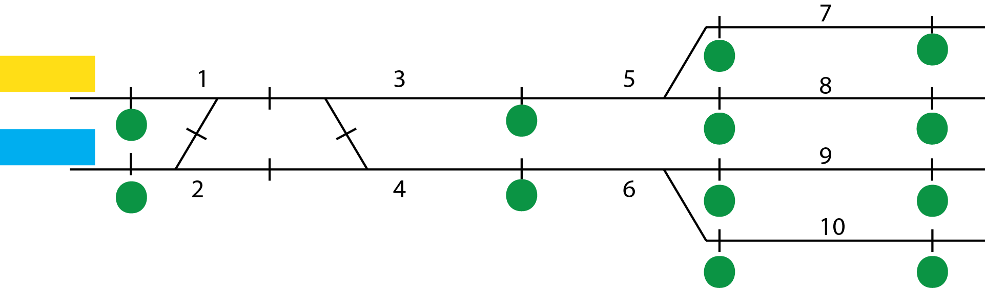
Some definitions
Introduction | Motivation | Methodology | Case study | Discussion
Station topology – detailed infrastructure
Resource – subset of infrastructure elements
  Track section, switch, crossing
A train route – set of resources
Blocking time – a time that a resource is reserved exclusively for a single train
Blocking time > running time over a resource

Slide 7
Introduction | Motivation | Methodology | Case study | Discussion
Introduction
Motivation
Solution approach
  Preprocessing
  TRP model
  RTRP model
  RTRP heuristics
Case study
Resource trees
Blocking times
Conflict constraints
Building a graph…

Slide 8
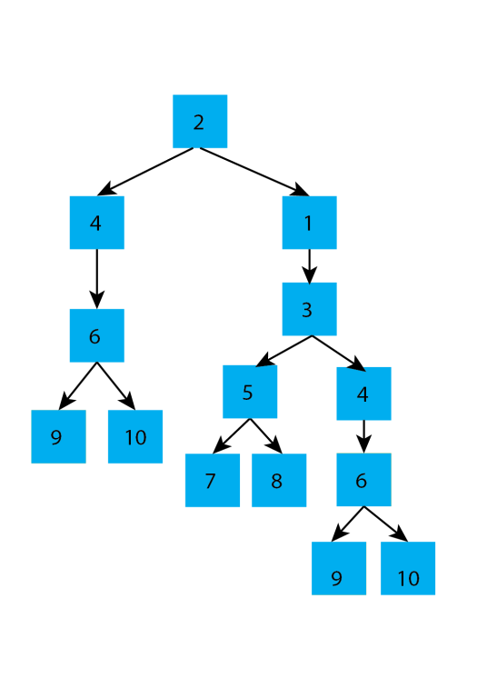
Preprocessing (1)
Introduction | Motivation | Methodology | Case study | Discussion
Resource trees
Blocking times
Conflict constraints
Resource tree – acyclic graph that includes all alternative routes

Slide 9


Preprocessing (1)
Introduction | Motivation | Methodology | Case study | Discussion
Resource trees
Blocking times
Conflict constraints
$$x_{train, resource}$$
Resource tree – acyclic graph that includes all alternative routes

Slide 10
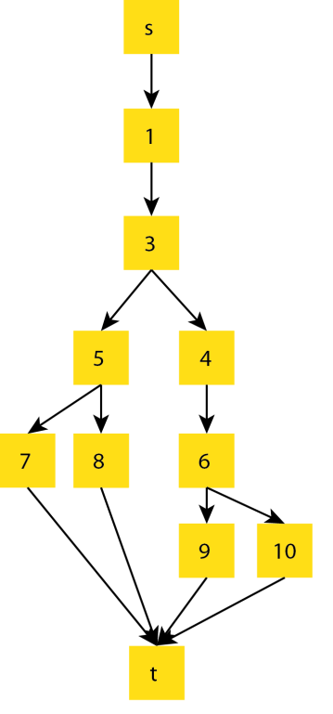
Preprocessing (1)
Introduction | Motivation | Methodology | Case study | Discussion
Resource trees
Blocking times
Conflict constraints
$$x_{train, resource}$$
Resource tree – acyclic graph that includes all alternative routes

Slide 11
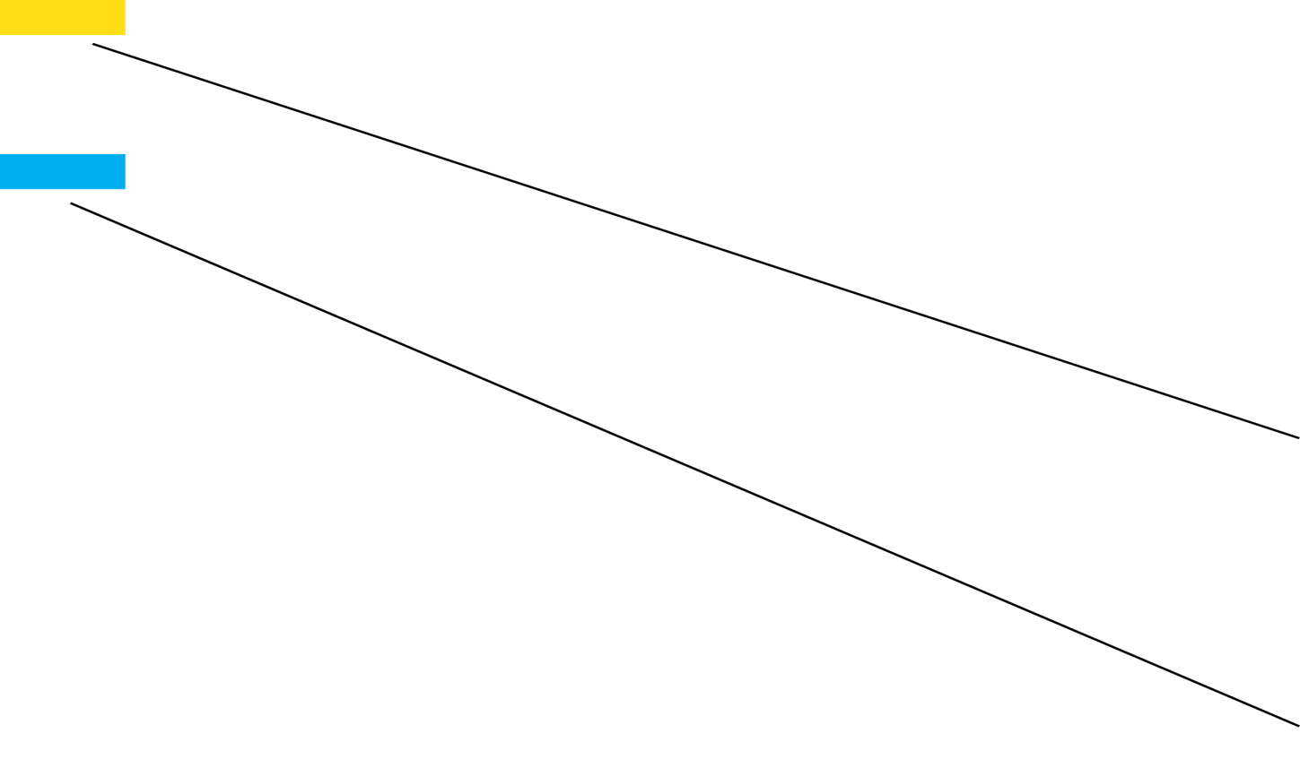
Preprocessing (2)
Introduction | Motivation | Methodology | Case study | Discussion
Resource trees
Blocking times
Conflict constraints
Time

Slide 12

Preprocessing (2)
Introduction | Motivation | Methodology | Case study | Discussion
Resource trees
Blocking times
Conflict constraints
Time

Slide 13
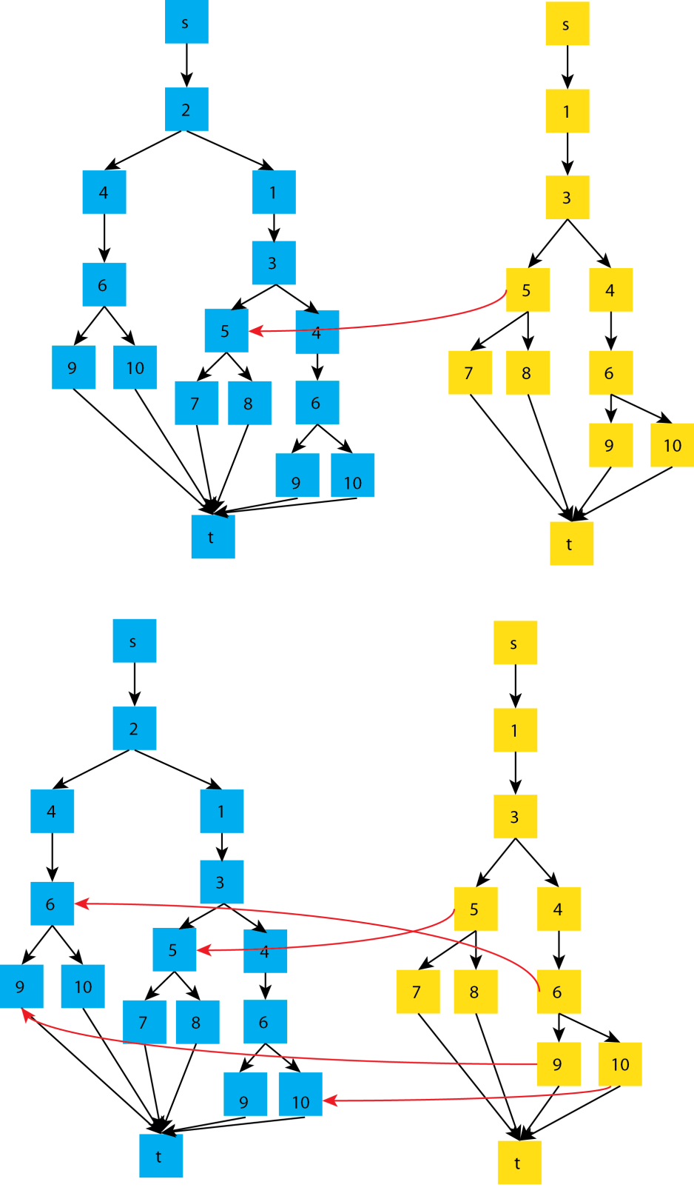

Preprocessing (3)
Introduction | Motivation | Methodology | Case study | Discussion
Resource trees
Blocking times
Conflict constraints
  $$x_{blue, 5}+x_{yellow,5}≤1$$

Slide 14

Preprocessing (3)
Introduction | Motivation | Methodology | Case study | Discussion
Resource trees
Blocking times
Conflict constraints
Conflict arcs:
  $$x_{zr}+x_{yq}≤1$$

Slide 15
Introduction | Motivation | Methodology | Case study | Discussion
Introduction
Motivation
Solution approach
  Preprocessing
  TRP model
  RTRP model
  RTRP heuristics
Case study

Slide 16

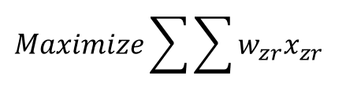

TRP model
Introduction | Motivation | Methodology | Case study | Discussion
Multi-commodity flow problem
Train = commodity
Objective
  Max quality of chosen routes
  (short running times)
Constraints
  Capacity constraints
  Flow conservation
  Conflict constraints
Caimi (2009)
  $$Maximize\sum{\sum{w_{zr}x_{zr}}}$$
$$\sum_{x_{zr}∈s_{z}}{x_{zr}=−1}$$
$$\sum_{x_{zr}∈t_{z}}{x_{zr}=1}$$

Slide 17
Introduction | Motivation | Methodology | Case study | Discussion
Introduction
Motivation
Solution approach
  Preprocessing
  TRP model
  RTRP model
  RTRP heuristics
Case study

Slide 18
RTRP model
Introduction | Motivation | Methodology | Case study | Discussion
Extension of TRP model 1. robustness
2. capacity occupation
Robustness = increase buffers between train routes (Caprara et al. 2011)
For two train routes
Buffer costs are assigned between leaves of resource trees
  $$Buffer cost= \left\{\begin{matrix}big M, & independent routes, \\ minimum headway, & otherwise.\end{matrix}\right.$$

Slide 19
RTRP model
Introduction | Motivation | Methodology | Case study | Discussion
Capacity occupation is a summation of critical processes as minimum headways, scheduled running or dwell times
Capacity occupation = critical (longest) path over chosen routes
Lower capacity occupation provides more time allowances
(i.e., better stability)
To evaluate capacity occupation minimum headways are needed
Add arcs with weights that correspond to minimum headways

Slide 20
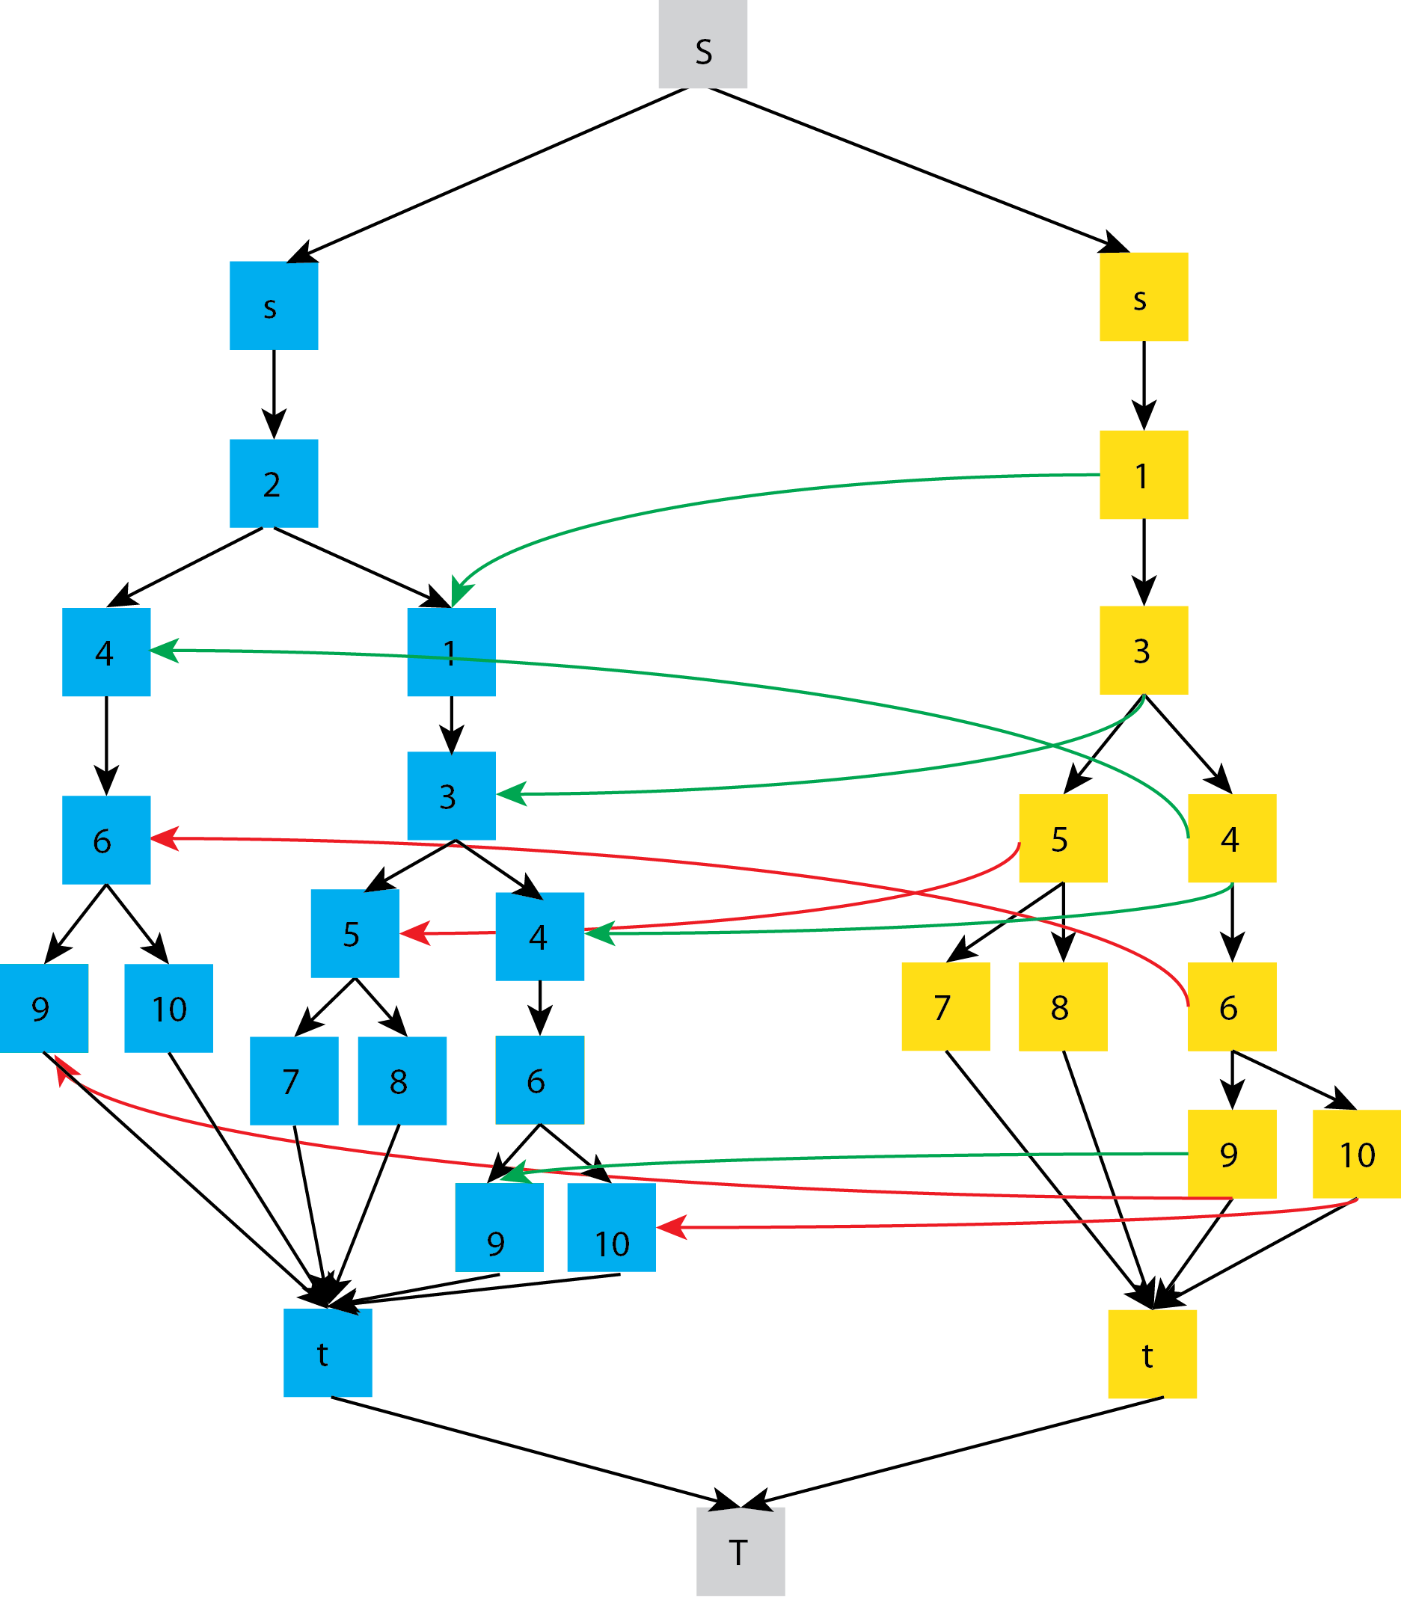
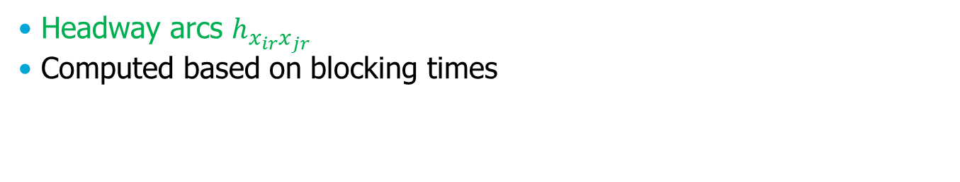

RTRP model
Introduction | Motivation | Methodology | Case study | Discussion
$$h_{x_{blue,1}x_{yellow,1}}$$
Headway arcs $h_{x_{ir}x_{jr}}$
Computed based on blocking times

Slide 21
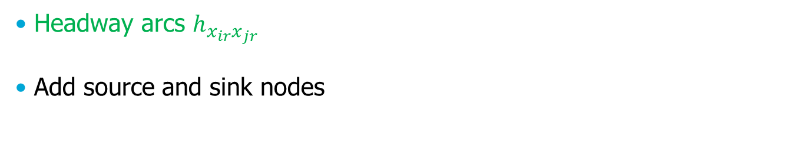
RTRP model
Introduction | Motivation | Methodology | Case study | Discussion
$$h_{x_{blue,1}x_{yellow,1}}$$
Headway arcs $h_{x_{ir}x_{jr}}$
Add source and sink nodes

Slide 22
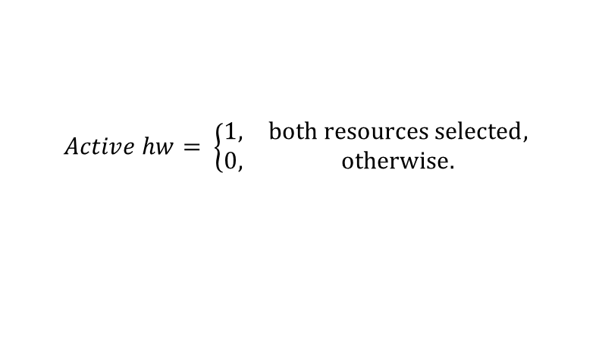
RTRP model
Introduction | Motivation | Methodology | Case study | Discussion
Active headways depend on selected routes
Active headway arcs
$$h_{x_{blue,1}x_{yellow,1}}$$
  $$Active hw= \left\{\begin{matrix}1, & both resources selected, \\ 0, & otherwise.\end{matrix}\right.$$

Slide 23
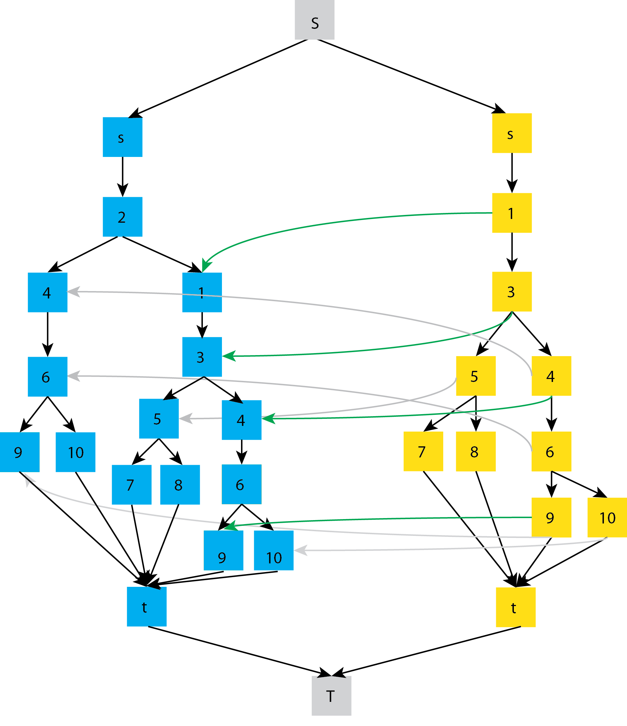
RTRP model
Introduction | Motivation | Methodology | Case study | Discussion
Active headways depend on selected routes
Active headway arcs
  $$Active hw= \left\{\begin{matrix}1, & both resources selected, \\ 0, & otherwise.\end{matrix}\right.$$
Directed acyclic graph
Find the critical path
Adjusted LP formulation for shortest path problem

Slide 24
RTRP model
Introduction | Motivation | Methodology | Case study | Discussion
Objectives
  Max quality of chosen routes
  Max robustness
  Min capacity occupation (critical path)
Constraints
  Capacity constraints
  Flow conversation
  Conflict constraints
  Active headways
  Shortest path constraints
  Maximum permitted capacity occupation
Developed heuristics for solving RTRP

Slide 25
Introduction | Motivation | Methodology | Case study | Discussion
Introduction
Motivation
Solution approach
  Preprocessing
  TRP model
  RTRP model
  RTRP heuristics
Case study

Slide 26

RTRP heuristics
Introduction | Motivation | Methodology | Case study | Discussion
Local search algorithm
Main components
  Capacity assessment (CA)
  Robustness evaluation (RE)
  Improvement rules (IR)
Algorithm of the RTRP heuristics
  Input: route plan $RP$
  Initialize $bestRP≔RP$
  While $iter<maxIter$ OR $not converged$
  Compute capacity occupation CA
  Compute delay propagation RE
  $totalCost\left(RP\right):=cost\left(CA\right)+cost(RE)$
  if $totalCost\left(RP\right)$ < $totalCost\left(bestRP\right)$
  $bestRP≔RP$
  end if
  vary routes in $RP$ (IR)
  End while

Slide 27
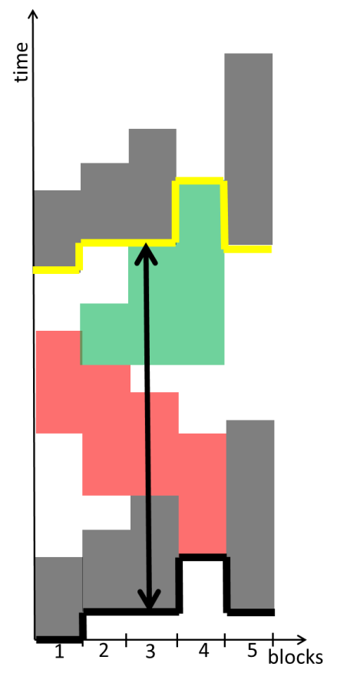
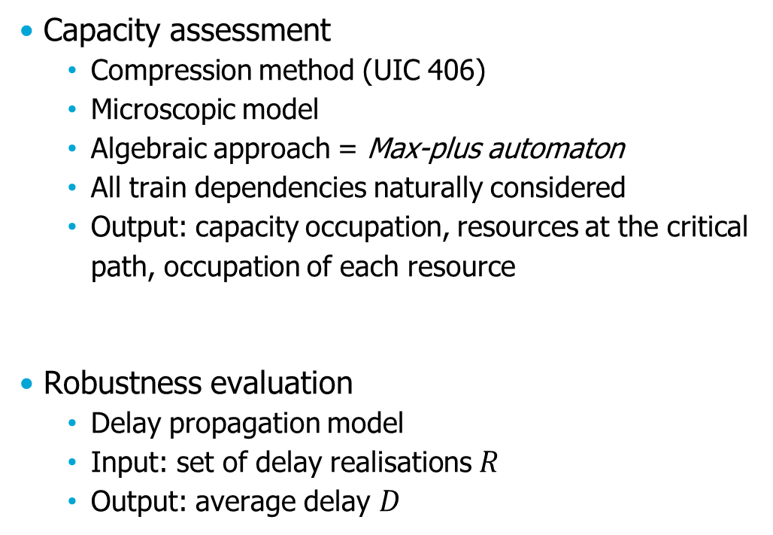
RTRP heuristics
Introduction | Motivation | Methodology | Case study | Discussion
Capacity assessment
  Compression method (UIC 406)
  Microscopic model
  Algebraic approach = Max-plus automaton
  All train dependencies naturally considered
  Output: capacity occupation, resources at the critical path, occupation of each resource
Robustness evaluation
  Delay propagation model
  Input: set of delay realisations $R$
  Output: average delay $D$

Slide 28
Methodology
Introduction | Motivation | Methodology | Case study | Discussion
Route permutations
Substitute bad train routes
Exclusion (E) and inclusion (I) rules for alternating routes in the route plan
E-rules. Choose a route that:
  has a resource is on the critical path
  uses a platform with the highest occupation
  generates the most delays
I-rules. Choose a route that:
  Does not use a resource on a critical path
  Does not use the highest utilised platform
  Is not conflicting with existing routes in the route plan

Slide 29
Introduction | Motivation | Methodology | Case study | Discussion
Introduction
Motivation
Solution approach
  Preprocessing
  TRP model
  RTRP model
  RTRP heuristics
Case study

Slide 30
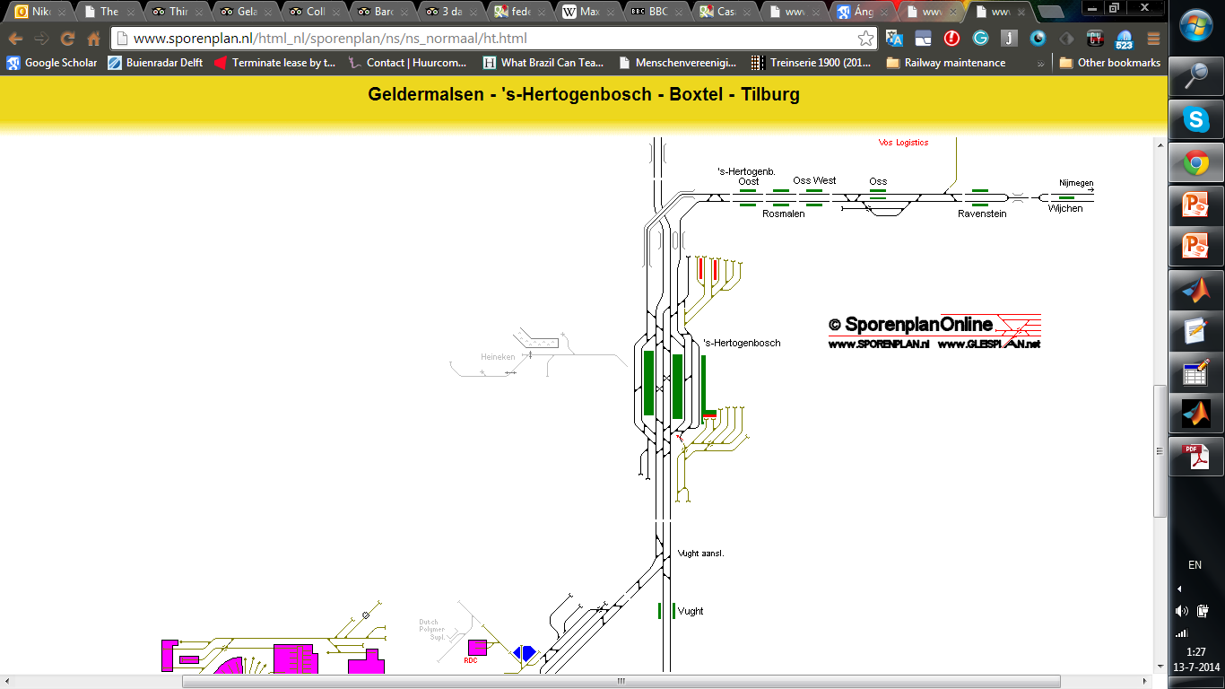
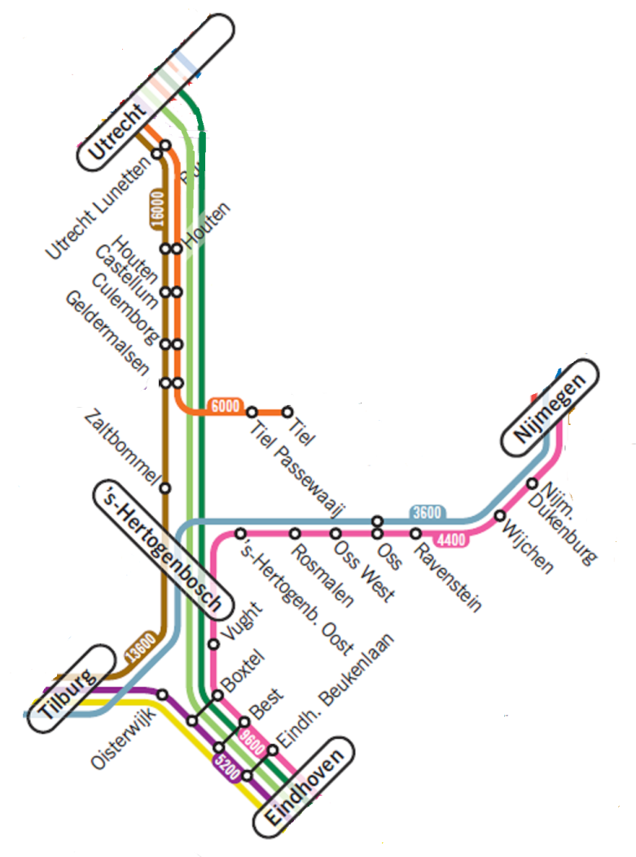
Case study
Introduction | Motivation | Methodology | Case study | Discussion
Station Den Bosch
14 trains lines with periodicity of 2 trains/h
Input: computed timetable
Besinovic et al. 2015
Table 1. Input parameters
Period (s) | 1800
# of platforms | 6
# of routes | 91
maxIter | 500
convIter (iterations without improvement) | 100

Slide 31
Case study
Introduction | Motivation | Methodology | Case study | Discussion
Initial results
Heuristics performance
30 repeated runs of RTRP heuristics
Weights for CA and RE are equal
Table 1. Heuristics convergence
Parameters | Mean (s) | Standard deviation (%)
Total cost (s) | 1135 | 0.73
# of iterations | 165 | 34.57

Slide 32
Case study
Introduction | Motivation | Methodology | Case study | Discussion
Initial results
Test single submodels CA and RE vs CA+RE
CA = original TRP
Table 2. Results of individual submodels
 | Capacity occupation (s) | Average delay (s) | Total cost (s) | Number of resources used
Only CA | 801 | 796 | 1597 | 72
Only RE | 956 | 301 | 1257 | 58
CA & RE | 821 | 314 | 1135 | 70

Slide 33
Conclusion
Introduction | Motivation | Methodology | Case study | Discussion
New multiobjective MILP formulation for robust train routing problem
Promising heuristics for solving RTRP
Optimized route plan fulfils
  Proven feasibility (at microscopic level)
  Capacity consumption reduced
  Improved robustness
  More even resource usage => less frequent maintenance
Future work
  Compare results with the optimal solution
  Flexible event times
  Evaluate the effect of different weights for CA and RE

Slide 34
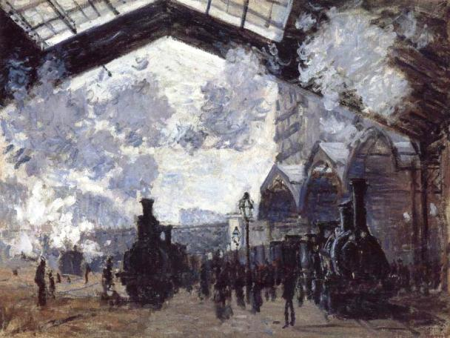
Thank you for your kind attention
n.besinovic@tudelft.nl

Slide 35
References
Sels P., Vansteenwegen P., Dewilde T., Cattrysse D., Waquet B., Joubert A., The train platforming problem: The infrastructure management company perspective, Transportation Research Part B: Methodological, Volume 61, March 2014, pp. 55-72
Besinovic N., Quaglietta E., Goverde R.M.P., A simulation-based optimization approach for the calibration of dynamic train speed profiles, Journal of Rail Transport Planning and Management, Journal of Rail Transport Planning & Management, Volume 3, Issue 4, 2013, pp. 126–136
Hansen I.A., Pachl J., Railway Timetable and Traffic, Eurailpress, Hamburg, Germany, 2008.
Viennot G.X., Heaps of pieces I: Basic definitions and combinatorial lemmas, lecture notes in mathematics, 1234,
Egmond R.J., An algebraic approach for scheduling train movements, The 8th International Conference on Computer-Aided Scheduling of Public Transport (CASPT 2000), Berlin, 21-23 June, 2000.
Goverde, R.M.P., Railway Timetable Stability Analysis Using Max-Plus Sys-tem Theory. Transportation Research Part B, 41(2), 179-201, 2007.
UIC Code 406: Capacity. International Union of Railways, Paris, 2nd Edition, June 2012.
Sparing D., Goverde R.M.P., An Optimization Model for Periodic Timetable Generation with Dynamic Frequencies, 16th International IEEE Conference on Intelligent Transport Systems (IEEE ITSC 2013), 6-9 October, The Hague, 2013.
Gaubert, S. and Mairesse, J., “Modeling and Analysis of Timed Petri Nets using Heaps of Pieces”, IEEE Transactions on Automatic Control, vol. 44, no. 4, pp. 683–697, 1999.

Slide 36
Case study
Introduction | Motivation | Framework | Methodology | Case study | Discussion
Optimized route plan
*red train route is repeated from the next period

Slide 37
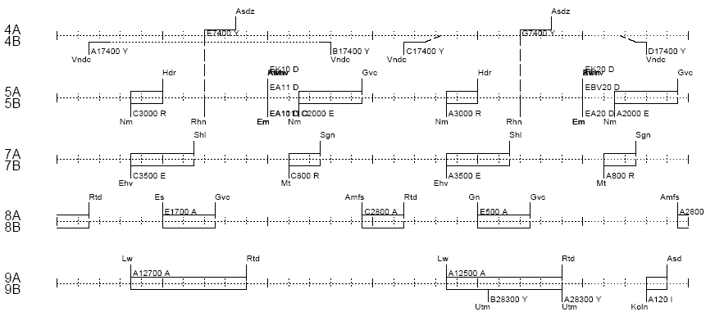
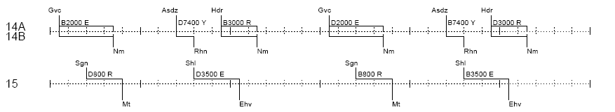
Train routing problem (TRP)
Introduction | Motivation | Methodology | Case study | Discussion
Platform utilization

Slide 38
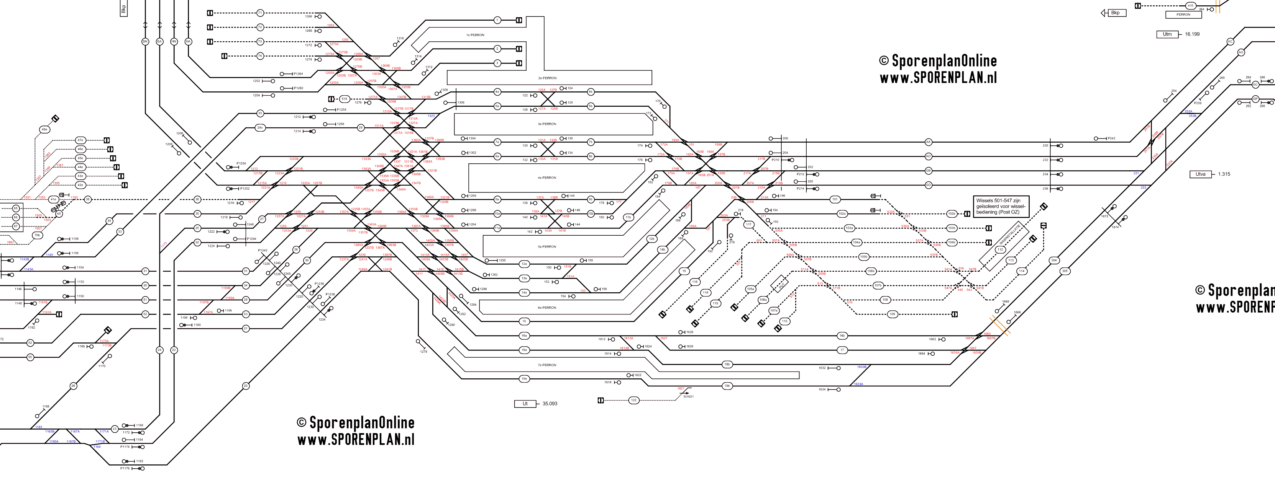
Train routing problem (TRP)
Introduction | Motivation | Methodology | Case study | Discussion
Routing possibilities
Utrecht Central

Slide 39
Introduction
Introduction | Motivation | Methodology | Case study | Discussion
Some definitions
Feasibility -The ability of all trains to adhere to their scheduled train paths
Stability -The ability of a timetable to absorb initial and primary delays so that delayed trains return to their scheduled train paths without rescheduling.
Robustness -The ability of a timetable to withstand design errors, parameter variations, and changing operational conditions.
Resilience - The flexibility of a timetable to prevent or reduce secondary delays using rescheduling measures (re-timing, re-ordering, re-routing).
  Realisable
  Conflict-free
Deliverable D3.1 (ONTIME, 2013)

Slide 40
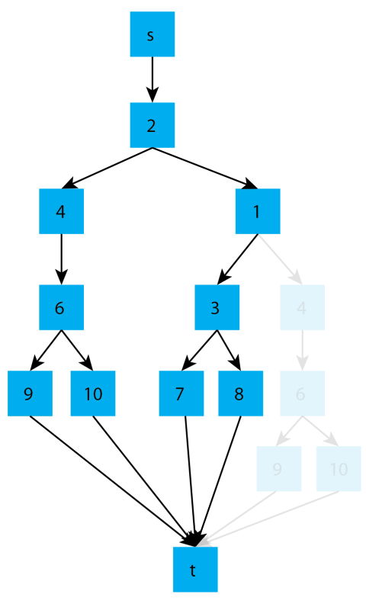
Preprocessing – Route reduction
Introduction | Motivation | Methodology | Case study | Discussion
Zwaneveld et al. (1996)
De Wilde et al. (2014)

Slide 41
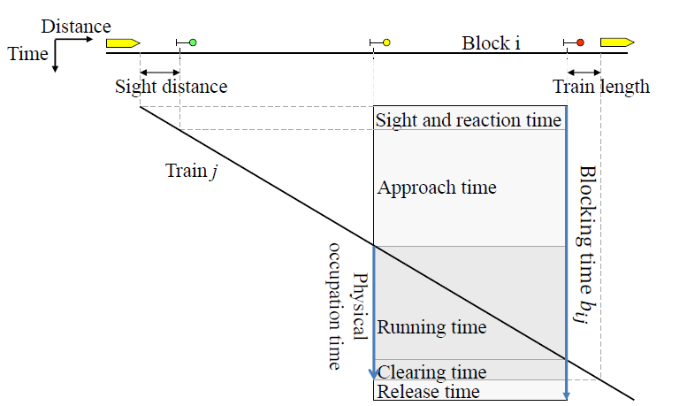

Preprocessing
Introduction | Motivation | Methodology | Case study | Discussion
Blocking time computation
Blocking time block i of train j

